Slide 1
Analytics Workshop
Advanced & predictive analytics
Set Up and Use Apache Iceberg Tables
on Your Data Lake
Christopher Sharkey
Analytics Solutions Architect
Amazon Web Services

Slide 2
Agenda
What is Iceberg?
How does Iceberg work?
AWS services commonly used with Iceberg?
Demonstration

Slide 3
What is Apache Iceberg?

Slide 4
“Iceberg is an open table format for huge analytic tables. Iceberg brings the reliability and simplicity of SQL tables to big data, while making it possible for engines like Spark, Trino, Flink, Presto, Hive and Impala to safely work with the same tables, at the same time.”
Notes:
• Iceberg is an open table format
• An open table format is a way to organize data files and bring database like features to a data lake
• We will cover what database like features means in our next slide
• The next part of the definition is huge tables
• Iceberg is design to work with large data sets that can have 1000s of partitions each of which can in turn have 1000s of underlying files
• The next part of the definition is SQL
• The other part of the definition is re. the engine that support Iceberg
• Many of the popular data processing engines support Iceberg
• Common examples include Spark, Trino, Flink, Presto, Hive and Impala

Slide 5
What are the benefits of using Apache Iceberg?
ACID compliance
Rollback and time travel
Flexible SQL
Hidden partitioning
Schema evolution
Notes:
• ACID compliance
- Iceberg guarantee isolated read and writes
- Readers will always see a consistent version of the data
- ‘No dirty reads’ … does this without the need to lock the table
• Rollback and time travel
- Iceberg captures changes or transactions in the form of snapshots
- A snapshot represents the stat of a table at some time
- bc. Iceberg captures changes in the form of snapshot is it possible query previous states of a table or roll back changes as long as we retain an appropriate snapshot history
• Flexible SQL
- Iceberg supports SQL commands for all of the common operations
- Examples include merge or updating data, deleting data, creating new tables
• Hidden partitioning
- Under an iceberg table, iceberg produces partitioned data files using column values
- This simplifies or hides the process of portioning data files
• Schema evolution
- Iceberg supports in-place table evolution
- You can use SQL to adjust a tables schema without the need to rewrite the entire data set

Slide 6
How does Iceberg work?
Notes:
How does Iceberg work and how does Iceberg achieve the benefits that I just talked about?
Lets dive deeper on Iceberg’s technical architecture

Slide 7
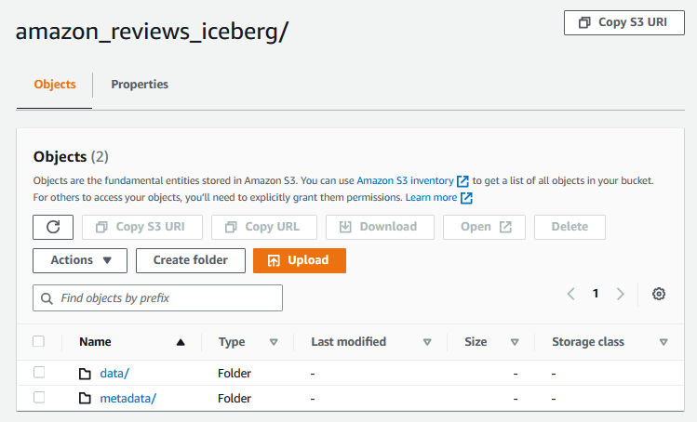
Metadata + Data Layer
Metadata
Metadata file
Manifest list(s)
Manifest file(s)
Data
Parquet files
Notes:
• Iceberg has two layers. A metadata layer and a data layer.
• Iceberg’s metadata layer has multiple layers to it. We will dive deeper into each of these layer in the next slides
• At a high level the metadata layer is what gives Iceberg the ability to capture snapshots, adapt to schema evolution and many other capabilities
• The data layer is where the actual data is stored. This layer contains the physical parquet files
• If you look at the screen shot I have. This is what the folder strcuture of an Iceberg table created on S3 looks likes. Notice the metadata and data folder
• As I mentioned earlier the metadata layer has sub-layers to it. These sub layers include a metadata file, manifest lists and manifest files
• Lets explore each of these in more detail

Slide 8
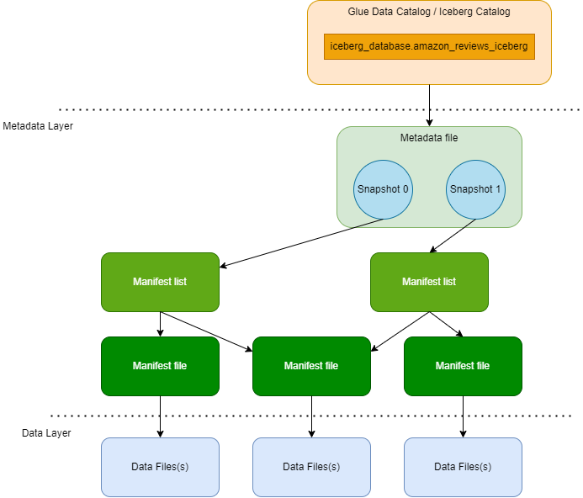
Metadata File
A snapshot is a complete set of data files in the table at a point in time
The table level metadata
Table schema, partitioning configuration, customer properties
Each metadata file can have 1 or more corresponding manifest lists
Notes:
• I want to call your attention to the diagram on the left hand side
• This is a representation of Iceberg’s metadata layers and the data layer
• Notice at the top of the diagram we have the Glue Data Catalog or the Iceberg Catalog which contains our table definition in this case the amazon_reviews table
• The definition for the amazon_reviews table points to our metadata file
• The metadata file has table level information • Examples include table schema, partitioning configuration … • You will also notice in the diagram that the metadata file in green has snapshots in it • As we discussed earlier a snapshot is a complete set of data files in the table at a point in time • The metadata file doesn’t contain all the information about the snapshots, it only know that in this example there is a snapshot 0 and snapshot 1 • To get the information about each of the snapshots that make up the table, the metadata file has pointers to manifest lists • Each metadata file can have 1 or more corresponding manifest lists

Slide 9
Manifest List
Snapshot level metadata
Defines a snapshot of a table
Each manifest list can have 1 or more corresponding manifest files
Notes:
• Now if we look at the manifest lists, this is the snapshot level metadata • The metadata file we previously discussed is the table level metadata, metadata files point to manifest lists, manifest lists are snapshot level metadata • Each snapshot has a manifest and it defines the snapshot • A manifest list does not have information about the actual data files that make up the snapshot • To find this information you may notice that the manifest lists point to manifest files • Each manifest lists can have 1 or more corresponding manifest files

Slide 10
Manifest File
Data level metadata
List of data files
Information about content of data files ex. column level statistics
Each manifest file can have 1 or more corresponding data files
Notes:
• The manifest files contain information about the data files • If you are following along the metadata file has table level information, the manifest list has snapshot level information and now the manifest files have datafile level metadata • This metadata may include information such as column level statistics • The information in the manifest lists is often used to help improve the performance of Iceberg queries • and finally each manifest file points to 1 or more data files

Slide 11
Data Files
Parquet Files
Actual data
Partitioning is applied
Notes:
• This finally brings us to the actual data files
• These are the physical parquet file that have the actual data

Slide 12
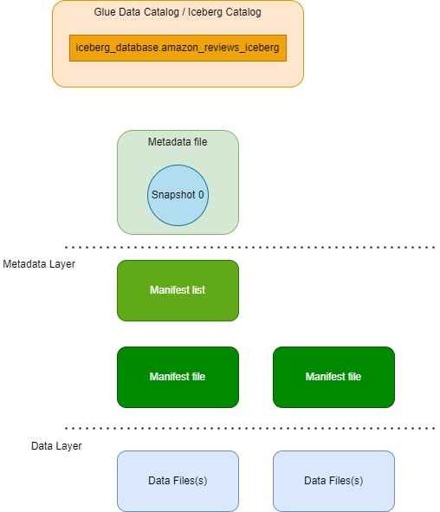
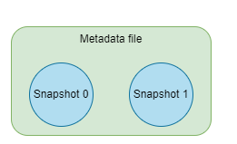
Step by Step
1. Write data to S3 via. Iceberg
2. Update several records in the Iceberg table and add several new records
Notes:
• I know the multiple levels of metadata in Iceberg can be confusing so I put together this animation to try and bring it all together

Slide 13
AWS services commonly used with Iceberg

Slide 14



AWS services commonly used with Iceberg
“Iceberg is a high-performance format for huge analytic tables. Iceberg brings the reliability and simplicity of SQL tables to big data, while making it possible for engines like Spark, Trino, Flink, Presto, Hive and Impala to safely work with the same tables, at the same time.”
Amazon EMR
AWS Glue
Amazon Athena

Slide 15
Demonstration

Slide 16
Resources
Iceberg on EMR and Athena Workshop
GitHub – Athena + Iceberg Materials
Blogs
Build a high-performance, ACID compliant, evolving data lake using Apache Iceberg on Amazon EMR
Implement a CDC-based UPSERT in a data lake using Apache Iceberg and AWS Glue
Built an Apache Iceberg data lake using Amazon Athena, Amazon EMR and AWS Glue

